Slide 1

Go, change the world
RV College of
Engineering
Unit - III
Decision Control and Looping Statements, and Arrays

Slide 2

Go, change the world
RV College of
Engineering
Contents – Unit III
Introduction to Decision Control Statements
Conditional Branching Statements
if Statement
if–Else Statement
if–Else–If Statement
switch-case
Iterative statements
while
do-while
for
Loop control statements
Arrays
Declaration of Arrays.
Accessing elements and Storing values in an array.
Operations on Arrays- Traversing, Inserting and Deletion of elements in an array.
Operations on Two Dimensional arrays.

Slide 3
Go, change the world
RV College of
Engineering
1. Control statements
Control statements are those, which exhibits controlled execution of statement/statements block in the program such as decision, looping and loop regulating statements.
Control statements help to jump control from one part of the program to another depending on whether a particular condition is satisfied or not.
C programming language provide three types of control statements.
Sequence Control Statements.
Selection or Decision Control Statements.
Repetition or Loop Control Statements.
Control statements
Sequence Control statements
Decision Control statements
Loop Control statements
if
If…else
If…else if…else
Switch…case
for
while
do…while

Slide 4
Go, change the world
RV College of
Engineering
Introduction to Decision Control Statements
Normally instructions in the program are executed in the same order in which they appear in the program. But in some cases we need to execute a set of instructions based on certain criteria.
Example : if the weather is sunny, then you will prefer to have cold drinks or juice but if the weather is cold, then you will prefer to have coffee or hot soup.
Depending on the situation we may want to execute a one set of instructions in one situation and in some other situation we may want to execute another set of instructions.
This way of controlled execution of statements can be achieved by using decision statements in the program, hence they are called as control statements.

Slide 5
Go, change the world
RV College of
Engineering
Introduction to Decision Control Statements…contd.,
Execution of different sets of instructions at different times is totally based on relational/logical condition.
Relational/Logical expression returns either true or false. If the test expression (condition) returns non-null and non-zero, then it is assumed as true, and if it is either zero or null, then it is assumed as false value.
Decision making statements use the outcome of Relational/Logical expression (true/false) and based on outcome, a specific set of instructions is executed.
This allows a program to take different courses of actions depending on different conditions.
C language has such decision making capabilities and supports the following statements known as control or decision making statements.
if
if-else
if-else-if
switch-case

Slide 6
Go, change the world
RV College of
Engineering
2. i) if statement
When you want to execute a statement or statement block based on condition, then if statement can be used.
Syntax of the if:
if (test expression)
{
statement 1;
............
statement n;
}
next_statement;
Use of curly brackets ({ }) for the statement block is optional in case if statement block is having only a single statement.
entry
test expression
true
statement 1;
............
statement n;
false
next_statement
If (statement) block
Flowchart of the if statement.

Slide 7
Go, change the world
RV College of
Engineering
if statement….contd.,
In the syntax, if is the keyword, and test expression(condition) is an expression that returns boolean value (true/false i.e., 1/0 (example., a<b, a!=0, a>b && b>c etc.,)).
If test expression is true, then statement/statement block immediately followed by if is executed, otherwise statement/statement block is ignored.
Then control passes from the if statement to the next_statement in the program unless one of the statements contains a break, continue, or goto statement.
Note that there is no semicolon after the test expression. This is because the condition and statement should be put together as a single statement.
Syntax of the if:
if (test expression)
{
statement 1;
............
statement n;
}
next_statement;

Slide 8
Go, change the world
RV College of
Engineering
Example for the if statement
Program given on the left side, we take a variable ‘x’ and initialize it to 10.
In the test expression, we check if the value of ‘x’ is greater than 0.
As 10 > 0, the test expression (x>0) evaluates to true, and the value of ‘x’ is incremented (x++, i.e., x=11).
Then the value of ‘x’ is printed on the screen. The output of this program is 11.
Observe that the printf("\n x = %d", x); statement will be executed even if the test expression is false.
#include<stdio.h>
int main()
{
int x=10;
if (x>0) x++;
printf("\n x = %d", x);
return 0;
}
#include<stdio.h>
int main()
{
int x=10;
if (x>0)
{
x++;
}
printf("\n x = %d", x);
return 0;
}
Same as
test expression
statement block
next_statement
Example - Program to increment and print a ‘x’, if value of x is more than 10.

Slide 9
Go, change the world
RV College of
Engineering
Additional examples for the if statement
Example 1. Write a Program to check if withdraw amount is more than balance or not, if withdraw amount is more than balance, then notify user for insufficient balance.
Example 2. Write a Program to ccompute income tax based on income and print net income tax to be paid based on income.
#include<stdio.h>
main()
{
int balance=20000,w_amount;
printf(“enter amount to withdraw: “); /*ask user to enter withdraw amount*/
scanf(“%d”,&w_amount); //read withdraw amount
if(w_amount>balance) /*check if withdraw amount is more than balance*/
{
/* if withdraw amount is more than balance, notify him insufficient balance*/
printf("Sorry, insufficient balance.!!!");
}
//otherwise do nothing and exit the program normally
return 0;
}
#include<stdio.h>
int main(){
float tax = 0, income;
printf("Enter your income\n");
scanf("%f", &income);
if(income>=250000 && income<=500000){
tax = tax + 0.05 * (income - 250000);
}
if (income >= 500000 && income <= 1000000)
{
tax = tax + 0.20 * (income - 500000);
}
if (income >= 1000000)
{
tax = tax + 0.30 * (income - 1000000);
}
printf("Your net income tax to be paid is: %f\n", tax);
return 0;
}

Slide 10
Go, change the world
RV College of
Engineering
Example 3. Write a Program to check he/she is passed or failed based on input marks.
Example 4. Write a Program to check whether he/she is eligible to retire or not.
#include<stdio.h>
main()
{
int marks;
printf("enter your marks"); //ask user to enter marks
scanf("%d",&marks);//read marks into memory
if(marks>50) //check if value of marks is greater than 50
{
//if marks is greater than 50, print “you are passed”
printf("you are passed");
}
if(marks<50) //check if value of marks is less than 50
{
//if marks is less than 50, print “you are failed”
printf("you are failed");
}
//otherwise do nothing and exit program normally
return 0;
}
#include<stdio.h>
main()
{
int age;;
printf(" enter your age: " ); //ask user to enter his/her age
scanf("%d",&age); //read age
if(age>=60) //check if his/her age is more than 59
{
/* if age is more than 59, then notify user “you can retire now*/
printf("you can retire now");
}
//otherwise do nothing and exit the program normally
return 0;
}

Slide 11
Go, change the world
RV College of
Engineering
Nested if statement
Syntax of the nested if:
if(test expression1)
{
if(test expression2)
{
inner if block;
}
inner next statement;
}
outer next statement;
Use of if within the body of another if is called as nested if.
When a series of conditions are to be evaluated for the value of a variable, we may have to nest an if statement, i.e., need to use inner if inside the outer if.
As per syntax of nested if, if the test expression1 is true it continues to perform the second test (test expression2). Otherwise it ignores the inner if and continues to execute the outer next statement.
If the test expression2 is true, it continues to execute the inner if block, otherwise control jumps to the inner next statement and it is executed.
After executing the inner next statement then the control is transferred to the outer next statement then it is executed and reaches the end of the program..
entry
false
test expression1
true
true
test epression2
false
inner if block
inner next statement
outer next statement
Flowchart of the nested if statement.

Slide 12
Go, change the world
RV College of
Engineering
Example for the Nested if statement
In the following example of nested if, the test expression1 (no<0) is evaluated first, if the condition returns true, it continues with execution of inner if. Otherwise control is transferred to printf(“\n Outer if is ignored.”); statement and it is executed.
During the execution of inner if, the test expression2 (no%2==0) is evaluated and if this condition is true, then the control is transferred to printf(“\n The given number is positive odd number.”); statement and it is executed.
Otherwise, the condition of inner if is false, then control is transferred to printf(“\n Inner if is ignored.”); statement and it is executed.
Now the control is shifted to printf(“\n Outer if is ignored.”); and then it is executed and it reaches the end of the program.
#include<stdio.h>
int main() {
int no;
printf(“\n Enter a number: “);
scanf(“%d”, &no);
if(no>0)
{
if(no%2==0)
{
printf(“\n The given number is positive odd number.”);
}
printf(“\n Inner if is ignored.”);
}
printf(“\n Outer if is ignored.”);
return 0;
}
Example - Program to check input number is positive odd number or not..

Slide 13
Go, change the world
RV College of
Engineering
2. ii) if-else statement
In case of if statement, when the test expression is evaluated to true, the statement block1 followed by the if statement is executed, otherwise the statement block1 is skipped by the compiler.
if-else is an extension of the ‘simple if’ statement and suppose if u want to execute a separate block of statements in case if condition returns false then we have to use if-else.
In the above syntax, if the test expression is true then the statement block1, immediately following the if statement is executed, otherwise the statement block2 is executed. Then control is shifted to statement x.
Syntax of the if-else:
if(test expression)
{
statement block1;
}
else
{
statement block2;
}
statement x;
entry
test expression
true
false
statement block1
statement block2
statement x
Flowchart of the if-else statement.

Slide 14
Go, change the world
RV College of
Engineering
Example for the if-else statement
Syntax of the if-else:
if(test expression)
{
statement block1;
}
else
{
statement block2;
}
statement x;
In either case, either statement block1 or statement block2 will be executed, but not both.
Control is then passed from the if statement to the statement x in the program unless one of the statements contains a break, continue, or goto.
After executing either statement block1 or 2, the control will move to statement x. Therefore, statement x is executed in every case.
Example,
#include<stdio.h>
int main()
{
int a;
printf("\n Enter the value of a : ");
scanf("%d", &a);
if(a%2==0)
printf("\n %d is even", a);
else
printf("\n %d is odd", a);
return 0;
}
In the program given on the left side, we declare variable ‘a’ of int type and read the value of ‘a’ from the user.
Now the control moves to the if statement, which checks whether the condition (a%2==0) is true or false.
if condition (a%2==0) is true, then printf("\n %d is even", a); is executed.
Otherwise, printf("\n %d is odd", a); is executed.
Now control moves to statement return 0; after if-else blocks;
Example - Program to check input number is odd or even..

Slide 15
Go, change the world
RV College of
Engineering
Additional examples for the if-else statement
Example 1: Write a Program to check age of the user, if age is above 17 print “You can vote” other print “You cant vote”.
Example 2: Write a Program to check age of the user, if user age is above 17 and below 71, then print “You can drive”, otherwise print “You cant drive”.
#include<stdio.h>
main()
{
int age;
printf("enter your age"); //ask user to enter his/her age
scanf("%d",&age); //read age
if(age>17) //check if age is greater than 17
{
/*if age is greater than 17, then display “you are eligible to vote”*/
printf("you are eligible to vote");
}
else
//otherwise, display “you are not eligible to vote”
printf("you are not eligible to vote");
return 0;
}
#include<stdio.h>
int main()
{
int age;
printf("Enter your age\n");//ask user to enter his/her age
scanf("%d", &age); //read age
if(age <= 70 && age>=18) /*check if age is above 18 and bellow 70*/
{
/*if age is above 18 and bellow 70, print You are above 18 and below 70, you can drive*/
printf("You are above 18 and below 70, you can drive\n");
}
else
{
//otherwise print You can’t drive
printf("You can’t drive\n");
}
return 0;
}

Slide 16
Go, change the world
RV College of
Engineering
Example 3: Write a program to check input character is uppercase character or lowercase character.
Example 4: Write a program to check percentage of marks scored, if percentage marks is less than 40 or Physics, chemistry and maths marks are less than 33, then print failed, otherwise print passed.
#include<stdio.h>
int main()
{
// 97-122 = a-z ASCII Values
char ch;
printf("Enter the character\n");
scanf("%c", &ch);
if(ch<=122 && ch>=97)
{
printf("It is lowercase character");
}
else
{
printf("It is not lowercase character");
}
return 0;
}
#include<stdio.h>
int main(){
int physics, chemistry, maths;
float total;
printf("Enter Physics Marks\n");
scanf("%d", &physics);
printf("Enter Chemistry Marks\n");
scanf("%d", &chemistry);
printf("Enter Maths Marks\n");
scanf("%d", &maths);
total = (physics + maths + chemistry)/3;
if((total<40) || physics<33 || maths<33 || chemistry<33){
printf("Your total percentage is %f and you are fail\n", total);
}
else{
printf("Your total percentage is %f and you are pass\n", total);
}
return 0;
}

Slide 17
Go, change the world
RV College of
Engineering
Nested if-else statement
Use of if-else within the body of another if-else is called as the nested if-else.
When a series of decisions are involved, we may have to use more than one if-else statement.
As per the syntax of if-else, if the test expression1 is false, then the statement block1_false will be executed otherwise it continues to perform the second test (test expression2).
If the test expression2 returns true, the statement block2_true will be executed, otherwise statement block2_false is executed.
Then the control is transferred from the inner if-else to the next_statement after the outer if-else.
Syntax of the nested if-else:
if(test expression1)
{
if(test expression2)
{
statement block2_true;
}
else
{
statement block2_false;
}
}
else
{
statement block1_false;
}
next_statement;

Slide 18
Go, change the world
RV College of
Engineering
Nested if-else statement….contd.,
Syntax of the nested if-else:
if(test expression1)
{
if(test expression2)
{
statement block2_true;
}
else
{
statement block2_false;
}
}
else
{
statement block1_false;
}
next statement;
entry
false
test expression1
true
test epression2
true
false
statement block1_false
statement block2_true
statement block2_false
next statement
Flowchart of the nested if-else statement.

Slide 19
Go, change the world
RV College of
Engineering
Additional examples for the nested if-else statement
Example 1: Write a program to check the input number is positive or not, if positive then check input is odd or even number.
Example 2: Write a program to find biggest among three numbers.
#include <stdio.h>
int main ()
{
int x, y, z;
printf ("Enter three number \n");
scanf ("%d %d %d", &x, &y, &z);
if (x>y) // first condition
{
//The code of this block will run when the first condition is true
if (x>z) // second condition
printf ("Greater value is: %d", x);
else
printf ("Greater value is: %d", z);
}
else {
/*If the first condition is False, then the code of this block will run.*/
if (y>z)
printf ("Greater value is: %d", y);
else
printf ("Greater value is: %d", z);
}
return 0;
}
#include<stdio.h>
void main()
{
int number;
printf("Enter a Number\n");
scanf("%d",&number);
if(number>0)
{
if(number%2==0) {
printf("%d is even. ",number);
}
else
{
printf("%d is odd. ",number);
}
}
else {
printf("enter a valid positive number") ;
}
return 0;
}

Slide 20
Go, change the world
RV College of
Engineering
Example 3: Write a program to check based on age of user, whether user is minor or senior citizen or eligible worker..
Example 4: Write a program to check given three numbers are equal or not.
#include <stdio.h>
int main() {
int age;
printf("Please Enter Your Age Here:\n");
scanf("%d",&age);
if ( age < 18 ) {
printf("You are Minor.\n");
printf("Not Eligible to Work");
}
else {
if (age >= 18 && age <= 60 ) {
printf("You are Eligible to Work \n");
printf("Please fill in your details and apply\n");
}
else {
printf("You are too old to work as per the Government rules\n");
printf("Please Collect your pension! \n");
}
}
return 0;
}
#include <stdio.h>
int main() {
// variables to store the three numbers
int a, b, c;
//take input from the user
scanf("%d %d %d", &a, &b, &c);
//if else condition to check whether first two numbers are equal
if (a == b) {
//nested if else condition to check if c is equal to a and b
if (a == c) {
//all are equal
printf("Yes");
} else {
//all are not equal
printf("No");
}
} else {
//the first two numbers are not equal, so they are not equal
printf("No");
}
return 0;
}

Slide 21
Go, change the world
RV College of
Engineering
2. iii) if-else-if statement
if–else-if is also called as else-if ladder and used to test additional conditions apart from the initial test expression.
When there are more than two test expressions (test expression1, test expression2.... test expression_{n}) to be evaluated, we need to use the else-if ladder.
As it is given in the syntax else-if ladder is a chain of if’s in which the statement associated with each else is an if (i.e., else-if). And if, else-if, else all these are having statement blocks associated with them.
As soon as a true condition is found, the statement block (statement block1 or statement block2 or statement block_{n}) associated with it is executed and the control is transferred to statement x.
When all the conditions become false, then the final else containing the default_block will be executed. Then control is transferred to statement x.
Syntax of the if-else-if:
if(test expression1)
{
statement block1;
}
else if(test expression2)
{
statement block2;
}
.
.
else if(test expression_{n})
{
statement block_{n};
}
else
{
default_block;
}
statement x;

Slide 22
Go, change the world
RV College of
Engineering
if-else-if statement….contd.,
Syntax of the if-else-if:
if(test expression1)
{
statement block1;
}
else if(test expression2)
{
statement block2;
}
.
.
else if(test expression_{n})
{
statement block_{n};
}
else
{
default_block;
}
statement x;
entry
test expression1
false
true
statement block1
true
test expression2
false
statement block2
test expression_{n}
false
true
statement block_{n}
default_block
statement x
Flowchart of the if-else-if statement.

Slide 23
Go, change the world
RV College of
Engineering
Example for the if-else-if statement
C supports simple if statements., so it is not necessary that every if statement should have an else block.
After the first test expression, the programmer can have as many else–if branches as he wants depending on the expressions that have to be tested.
In the following example, the program tests that the given number is equal to zero, positive, or negative.
Note that if the first test expression (num==0) evaluates to a true value, then the rest of the statements in the code will be ignored after executing printf("\n The value is equal to zero"); statement.
Otherwise if the first test expression (num==0) returns false, test expression (num>0) is evaluated. If test expression num>0 is true, printf("\n The number is positive"); statement is executed. Otherwise it executes printf("\n The number is negative"); statement.
Then the control will jump to return 0 statement.
#include
int main()
{
int num;
printf("\n Enter any number : ");
scanf("%d", &num);
if(num==0)
printf("\n The value is equal to zero");
else if(num>0)
printf("\n The number is positive");
else
printf("\n The number is negative");
return 0;
}
Example - Program to check the given number is positive or negative or equal to zero.

Slide 24
Go, change the world
RV College of
Engineering
Example 1: Write a program to print grade of the user based on the input marks.
#include<stdio.h>
void main()
{
int marks;
printf("Enter your marks ");
scanf("%d",&marks);
if(marks<0 || marks>100)
{
printf("Wrong Entry");
}
else if(marks<50)
{
printf("Grade F");
}
else if(marks>=50 && marks<60)
{
printf("Grade D");
}
else if(marks>=60 && marks<70)
{
printf("Grade C");
}
else if(marks>=70 && marks<80)
{
printf("Grade B");
}
else if(marks>=80 && marks<90)
{
printf("Grade A");
}
else
{
printf("Grade A+");
}
}

Slide 25
Go, change the world
RV College of
Engineering
Example 2: Write a program to compute Electricity bill based on total units consumed.
Example 3: Write a program to compare two numbers n1 and n2 and find n1 is equal to n2 or n1 is less than n2 or n1 more than n2.
#include<stdio.h>
void main()
{
int units;
float e_bill;
printf("Enter number of units consumed: ");
scanf("%d",&units);
if(units>0 && units<=100)
{
e_bill=units*2+15;
}
else if(units >100 && units<=200)
{
e_bill=units*3+25;
}
else if(units>200 && units<=300)
{
e_bill=units*3+35;
}
else
{
e_bill=units*5+50;;
}
printf("\nThe electricity billing amount is Rs. %f ", e_bill);
}
#include<stdio.h>
void main()
{
int n1,n2;
printf("Enter two numbers: ");
sc
anf("%d %d",&n1,&n2);
if(n1 == n2)
{
printf("Both %d and %d are equal. ", n1, n2 );
}
else if(n1>n2)
{
printf( " %d is greater than %d ", n1,n2 );
}
else if(n1<n2)
{
printf(" %d is smaller than %d ", n1, n2 );
}
else
{
printf(",%d and %d are not related", n1, n2 );
}
}

Slide 26
Go, change the world
RV College of
Engineering
Example for the nested if-else-if statement
if-else-if inside another if-else-if construct is called as nested if-else-if.
#include<stdio.h>
void main()
{
int college,program;
printf("\n1. College A\n2. College B\n3. Exit\n");
printf("\nEnter your college: ");
scanf("%d",&college);
if(college==1)
{
printf("\n1. Program X1\n2. Program Y1\n3. Program Z1");
printf("\nEnter your choice: ");
scanf("%d",&program);
if(program==1)
printf("\nYour CET rank should be [1-100] to get into Program X1.");
else if(program==2)
printf("\nYour CET rank should be [101-500]to get into Program X1.");
else if(program==3)
printf("\nYour CET rank should be [501-999]to get into Program X1.");
else
printf("\nEnter valid program [1-3]");
}
else if(college==2)
printf("There are no seats available, good luck for next year!!!");
else
exit(0);
}
else if(college==2)
{
printf("\n1. Program X2\n2. Program Y2\n3. Program Z2");
printf("\nEnter your choice: ");
scanf("%d",&program);
if(program==1)
{
printf("\nYour CET rank should be [1000-2000] to get into program X2.");
}
else if(program==2)
{
printf("\nYour CET rank should be [2001-5000]to get into program X2.");
}
else if(program==3)
{
printf("\nYour CET rank should be [5001-9999]to get into program X2.");
}
else
{
printf("\nEnter valid program [1-3]");
}
}
else
{
printf("\nEnter valid college [1-5]");
}
}

Slide 27
Go, change the world
RV College of
Engineering
2. iv) switch-case statement
A switch-case statement is a multi-way decision statement that is a simplified version of an if– else–if block.
Switch is a control statement that allows a value of any variable to change control of execution and switch makes one selection when there are several choices to be made. As an alternative to switch-case still we can use an if-else-if statement.
But use of if-else-if is not suggested if the number of alternative conditions increases as it leads to increase in complexity of the program.
In switch-case statement the values of a given variable (or expression) are tested against a list of case constants or constant expressions(case values) and when a match is found a block of statements associated with that case is executed.
switch-case is mostly used when there is only one variable to evaluate in the expression and as switch-case statement compare the value of variable to only integer case constant, so the value of variable must be an integer or character type.
The default label is optional and it is executed only when the value of expression does not match with any of the case constants or expression constants.
The default label can be placed anywhere in the switch-case construct.

Slide 28
Go, change the world
RV College of
Engineering
switch-case statement….contd.,
Compared to switch-case, one advantage of using if–else–if statement is that it can evaluate more than one expression in a single logical structure and value of variable or expression not necessarily be an integer type or character type.
Advantages of Using a switch-case statement Switch–case statement is preferred by programmers due to the following reasons:
Easy to debug
Easy to read and understand
Ease of maintenance as compared to its equivalent if–else statements
Like if–else statements, switch statements can also be nested
Executes faster than its equivalent if–else construct

Slide 29
Go, change the world
RV College of
Engineering
switch-case statement….contd.,
As it is given in the syntax, the input value of variable is compared with case values (value1, value2….value N)based on the match with specific case value, statement block (statement block1 or statement block2 or statement block N)followed by that case is going to be executed.
default is an optional case that is executed when the value of the variable does not match with any of the case values and it is always recommended to include it, as it handles any unexpected case.
In the syntax note that, there is another keyword called break, it must be used at the end of each case, this is because if it is not used, then the case that is matched along with all the following cases till next break will be executed.
The break statement tells the compiler to jump out of the switch-case construct after executing the corresponding statement block of a matched case and pass the control to statement X.
Syntax of the switch-case: switch (variable) { case value1: statement block1; break; case value2: statement block2; break; ..................... case value N: statement block N; break; default: statement block D; } statement X;

Slide 30
Go, change the world
RV College of
Engineering
switch-case statement….contd.,
true
value1
Syntax of the switch-case: switch (variable) { case value1: statement block1; break; case value2: statement block2; break; ..................... case value N: statement block N; break; default: statement block D; } statement X;
statement block1
false
true
value2
statement block2
false
false
true
value N
statement block N
false
statement block D
statement X
Flowchart of the nested switch-case statement.

Slide 31
Go, change the world
RV College of
Engineering
Example for the switch-case statement
In the example, we declare the variable ‘ch’ of char type, after reading the ‘ch’ value, it is compared with case constants (case values i.e., A, a, E, e, I, i, O, o, U, u) of case statements.
Once the value of ‘ch’ matches to any of the case constants, a block of statements immediately followed by the corresponding case statement is executed.
In the example, there is no break after the case ‘A’, if the value of ‘ch’ matches ‘A’, then all the case blocks till the next break statement are executed and then control exit from the switch-case construct.
If the value of ‘ch’ does not matches with any of the case constants, then the program prints that the character is not a vowel (default case).
#include <stdio.h>
int main()
{
char ch;
printf("\n Enter any character : ");
scanf("%c", &ch);
switch(ch)
{
case 'A':
case 'a':
printf("\n %c is VOWEL", ch);
break;
case 'E':
case 'e':
printf("\n %c is VOWEL", ch);
break;
case 'I':
case 'i':
printf("\n %c is VOWEL", ch);
break;
case 'O':
case 'o':
printf("\n %c is VOWEL", ch);
break;
case 'U':
case 'u':
printf("\n %c is VOWEL", ch);
break;
default: printf("\n %c is not a vowel", ch);
}
return 0;
}
Example C Program to check the given character is vowel or not.

Slide 32
Go, change the world
RV College of
Engineering
Additional examples for the switch-case statement
Example 1: Write a program to perform arithmetic operation based on the user choice.
#include<stdio.h>
void main()
{
int n1,n2,choice;
float result;
printf("\nEnter numbers n1 and n2: ");
scanf("%d %d",&n1, &n2);
printf("\n1. Addition\n2. Subtraction\n3. Multiplication\n4. Division\n5. Exit\n");
printf("\nEnter your choice: ");
scanf("%d",&choice);
switch(choice)
{
case 1:
result=n1+n2;
break;
case 2:
result=n1-n2;
break;
case 3:
result=n1*n2;
break;
case 4:
result=(float)n1/(float)n2;
break;
case 5:
exit(0);
default:
printf("\nenter valid choice [1 - 5]");
}
printf("\nresult is %lf",result);
return 0;
}

Slide 33
Go, change the world
RV College of
Engineering
Example 2: Write a program to display marks range to be secured to obtain input grade.
#include<stdio.h>
void main()
{
char grade;
printf("\nEnter your Grade: ");
scanf("%c",&grade);
switch(grade)
{
case 'S':
case 's':
printf("Marks range to secure S grade is: 90-100");
break;
case 'A':
case 'a':
printf("Marks range to secure A grade is: 75-89");
break;
case 'B’:
case 'b':
printf("Marks range to secure B grade is: 65-74");
break;
case 'C':
case 'c':
printf("Marks range to secure C grade is: 55-64");
break;
case 'D':
case 'd':
printf("Marks range to secure D grade is: 50-54");
break;
case 'E':
case 'e':
printf("Marks range to secure E grade is: 40-49");
break;
case 'F':
case 'f':
printf("Marks range to secure F grade is: 00-39");
break;
default:
printf("\nEnter valid Grade [A|a - F|f]: ");
}
return 0;
}

Slide 34
Go, change the world
RV College of
Engineering
Example 3: Write a program to display Rank range based on college choice. [note that you have to assume hypothetical college names and rank range.]
#include<stdio.h>
void main()
{
int choice;
printf("\n1. College A\n2. College B\n3. College C\n4. College D\n5. College E");
printf("\nEnter your choice: ");
scanf("%d",&choice);
switch(choice)
{
case 1:
printf("\nYour CET rank should be <1000.");
break;
case 2:
printf("\nYour CET rank should be [1000 - 9999].");
break;
case 3:
printf("\nYour CET rank should be [10000-19999].");
break;
case 4:
printf("\nYour CET rank should be [20000-39999].");
break;
case 5:
printf("\nYour CET rank should be [30000-49999].");
break;
default:
printf("\nYour wont get seat in any college".);
}
return 0;
}

Slide 35
Go, change the world
RV College of
Engineering
Example for the nested switch-case statement
The inner switch-case inside an outer switch-case is called a nested switch-case and we can nest any number of switch-case statements, there is no restriction for it. The case constants of the inner and outer switch may have common values.
In the example, the program asks the user to type his ID, and if the ID is valid then it will ask him to enter his password.
If the password is correct the program will print “Welcome dear Programmer”, otherwise, the program will print Incorrect Password and if the ID does not exist, the program will print Incorrect ID.
An outer switch construct is used to compare the value entered in variable ID. It execute the statement block associated with the matched case(when ID==500).
If the statement block is executed with the matched case, an inner switch is used to compare the values entered in the variable password and execute the statements linked with the matched case(when password==000).
Otherwise it executes the default case of the inner switch-case construct.
#include <stdio.h>
int main() {
int ID = 500;
int password = 000;
printf("Plese Enter Your ID:\n ");
scanf("%d", & ID);
switch (ID) {
case 500: //ID==500
printf("Enter your password:\n ");
scanf("%d", & password);
switch (password) {
case 000: //password==000
printf("Welcome dear Programmer\n");
break;
default:
printf("incorrect password");
break;
}
break;
default:
printf("incorrect ID");
break;
}
}
Example C Program to evaluate hypothetical username and password.

Slide 36
Go, change the world
RV College of
Engineering
Example of the nested switch-case…contd.,
Example 1: Write a program to display Rank range program wise based on college choice. [note that you have to assume hypothetical college names and rank range.]
#include<stdio.h>
void main()
{
int college,program;
printf("\n1. College A\n2. College B\n");
printf("\nEnter your choice: ");
scanf("%d",&college);
switch(college)
{
case 1:
printf("\n1. Program X1\n2. Program Y1\n3. Program Z1");
printf("\nEnter your choice: ");
scanf("%d",&program);
switch(program)
{
case 1:
printf("\nYour CET rank should be [1-100].");
break;
case 2:
printf("\nYour CET rank should be [101-500].");
break;
case 3:
printf("\nYour CET rank should be [501-999].");
break;
default:
printf("\nEnter valid program [1-3]");
}
break;
case 2:
printf("\n1. Program X2\n2. Program Y2\n3. Program Z2");
printf("\nEnter your choice: ");
scanf("%d",&program);
switch(program)
{
case 1:
printf("\nYour CET rank should be [1000-2000].");
break;
case 2:
printf("\nYour CET rank should be [2001-5000].");
break;
case 3:
printf("\nYour CET rank should be [5001-9999].");
break;
default:
printf("\nEnter valid program [1-3]");
}
break;
default:
printf("\nEnter valid college [1-5]");
}
return 0;
}

Slide 37
Go, change the world
RV College of
Engineering
3. Iterative Statements
Apart from conditional statements, programming languages usually supports another important control structures called iterative statements (loop/repetitive statements) and they are used to repeat the execution of a sequence of statements (statement block) as long specified condition remains true.
A loop is one of the most fundamental logical structures in computer programming that allow computers to repeat specific task such as,
Computing Fibonacci series up to n (n is a certain number), Printing of “R V College of Engineering” 10 times, Computing n prime numbers, Playing of favorite song n times, Computing area of 100 circles with different radii and many more.,
Loop structure requires loop control variable and three important expressions viz., initialization, test expression, increment/decrement and every loop statement is followed by a sequence of statements called as the statement block.
The execution of the statement block is repeated as long as the test expression (condition) returns true and stops only after the test expression returns false.
Value of a loop variable acts as a controlling factor for the repetition of execution of the statement block, hence the loop variable is usually called as the control variable for the loop.

Slide 38
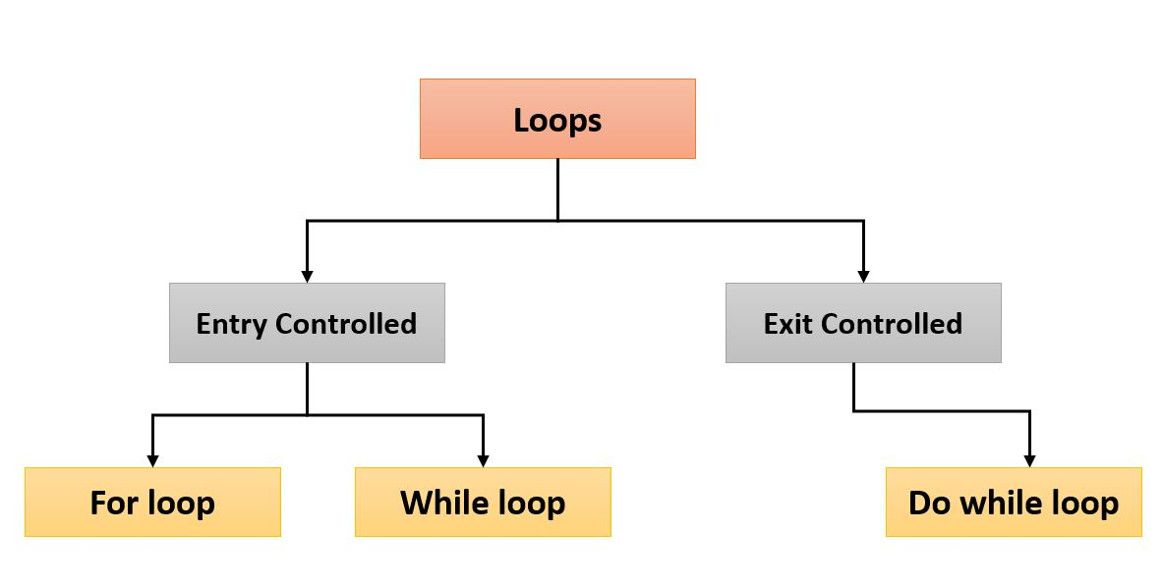
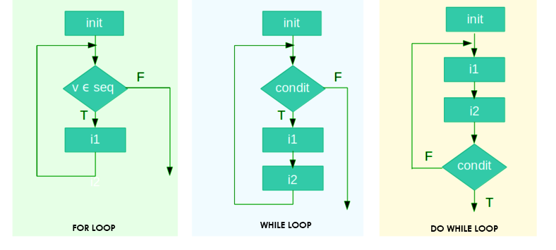
Go, change the world
Key difference between entry controlled Loop and exit controlled Loop is that
Entry loop, loop block won’t execute if test expression returns false., whereas in case of exit loop, loop block will be executed even though test expression returns false.`
RV College of
Engineering
3. Iterative Statements
Key difference between entry controlled Loop and exit controlled Loop is that
Entry loop, loop block won’t execute if test expression returns false.
Exit loop, loop block will be executed even though test expression returns false.

Slide 39
Go, change the world
RV College of
Engineering
Iterative Statements….contd.,
Loops are classified as entry controlled Loops and exit controlled Loops
Entry controlled Loops are those in which test expression is evaluated before execution of loop block (statement block). Example: while and for.
Whereas exit controlled Loops are those in which test expression is evaluated only after execution of loop block. Example do-while.
Loops can also be classified as definite loops and indefinite loops
Definite loop is one in which number of repetitive executions (iterations) of loop block is known. Example for.
Indefinite loop is the one in which number of iterations are not known, they keep repeating execution of loop block as long as test expression of loop returns true.
Example: while and do-while.
C supports all the three types of loop statements i.e., it supports while, do-while and for statements.

Slide 40
Go, change the world
RV College of
Engineering
3. i) while Loop
The while loop provides a mechanism to repeat the statement block as long as test the condition returns true.
As it is given in the syntax, note that in the while loop, the condition is tested before the execution of any of the statements in the statement block.
If the condition is true, only then the statement block will be executed, otherwise if the condition is false, the control will jump to statement y, that is the immediate statement outside the statement block.
The value of the while loop variable that is tested with condition determines when the loop will end.
In order to continue execution of the statement block we need to constantly update the loop control variable of the while loop either by incrementing or decrementing its value.
Note that if the loop variable is not updated, then the condition never becomes false, as a result loop becomes infinite loop.
Syntax of while Loop:
statement x;
while (condition)
{
statement block;
}
statement y;
statement x
Update the condition Expression
condition
statement block
True
False
statement y
Flowchart of the while loop.

Slide 41
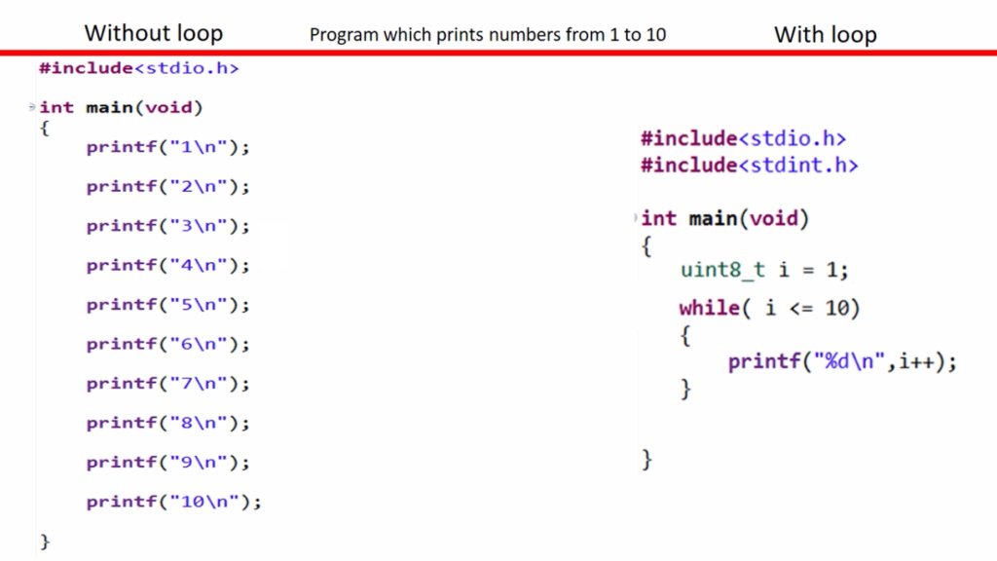
Go, change the world
RV College of
Engineering
3. i) while Loop

Slide 42
RV College of
Engineering
Example of while Loop
For example, the following code prints the first 10 numbers using a while loop. In the program ‘i’ is the loop variable that is initialized to 1.
Note that initially ‘i’ is less than 10, i.e., the condition (i<=10) in the loop returns true, so control is moved to statement block and executes it i.e., prints value of ‘i’ (printf("\n %d", i);) and update the ‘i’ value (i = i + 1; ).
Since we are still in the while loop, after increasing the ‘i’ value by 1, again the condition is evaluated with the updated ‘i’ value.
If condition (i<=10) returns true, then again there will be one more execution of the statement block. This process is repeated again and again till ‘i’ becomes 11.
When i=11, the condition (i<=10) becomes false and the loop ends and control will jump to return 0;, execute it and exit the program.
#include <stdio.h>
int main()
{
int i = 1;
while(i<=10)
{
printf("\n %d", i);
i = i + 1; // condition updated
}
return 0;
}
Example C Program to print first 10 serial numbers.

Slide 43
RV College of
Engineering
Example of while Loop
1.Write a program to calculate sum of N natural numbers.
2. Write a program to calculate sum of numbers from m to n.
3. Write a program to read the numbers until -1 is encountered. Also count the number of negatives, positives and zeros entered by user.
4. Write a program to print sum and average of the numbers entered by user.
5. Write a program to print the N numbers in reverse order using While Loop
6. Write a program to print Fibonacci series using While Loop

Slide 45
RV College of
Engineering
Example of while Loop
/* Sum of N Natural Numbers*/
#include <stdio.h>
int main() {
int n, i, sum = 0;
printf("Enter a positive integer: ");
scanf("%d", &n);
i = 1;
while (i <= n) {
sum += i; /* sum=sum+i;*/
++i; /* i=i+1;*/
}
printf("Sum = %d", sum);
return 0;
}

Slide 46
RV College of
Engineering
Example of while Loop
/* Fibonacci Series*/
#include <stdio.h>
int main ()
{
int i, n, j, k;
printf ("Enter a Number : ");
scanf ("%d", &n);
i = 0;
j = 1;
printf ("%d %d ", i, j);
k = i + j;
while (k <= n)
{
printf (" %d", k);
i = j;
j = k;
k = i + j;
}
return 0;
}

Slide 47
RV College of
Engineering
Additional examples for the while Loop
Example 1: Write a program to print sum and average of the numbers entered by user.
#include<stdio.h>
int main()
{
int i=-1,num=0,sum=0;
float avg;
printf("\n Enter -1 to exit!");
printf("\n Enter numbers: \n");
while(num!=-1)
{
sum+=num;
scanf("%d",&num);
i++;
}
avg=(float)sum/i;
printf("sum: %d, and average: %f\n",sum,avg);
return 0;
}
Example 2:Write a program to display biggest among the 5 numbers.
#include<stdio.h>
int main()
{
int i=1,large=-32768, num;
float avg;
while(i<=5)
{
printf("\n Enter any number: ");
scanf("%d", &num);
large=large>num?large:num;
i++;
}
printf("\n Biggest among 5 numbers is: %d", large);
return 0;
}

Slide 48
RV College of
Engineering
Example 3: Write a program to calculate sum of numbers from m to n.
#include<stdio.h>
int main()
{
int n, m, sum=0;
printf("\n Enter -1 to exit...");
printf("\n Enter the value of m and n: ");
scanf("%d %d", &m, &n);
while(m<=n)
{
sum+=m;
m++;
}
printf("\n Sum = %d ", sum);
return 0;
}
Example 4:Write a program to read the numbers until -1 is encountered. Also count the number of negatives, positives and zeros entered by user.
#include<stdio.h>
int main()
{
int num;
int positives=0,negatives=0, zeros=0;
printf("\n Enter -1 to exit...");
printf("\n Enter any number: ");
scanf("%d", &num);
while(num!=-1)
{
if(num>0)
positives++;
else if(num<0)
negatives++;
if(num==0)
zeros++;
printf("\n Enter any number: ");
scanf("%d", &num);
}
printf("\n No. of positive numbers: %d\tNo. of negative numbers: %d\tNo. of zeros: %d",positives,negatives, zeros);
return 0;
}

Slide 49
RV College of
Engineering
Example for the nested while Loop
The inner while loop defined inside the outer while loop is called as nested while loop. The following is an example of how we can use a nested while loop, where we have created the 2D array (int a[rows][columns]) using a nested while loop.
In the example, after declaring and reading the values for rows and columns, the ‘i’ is declared and it is initialized to 0. Now, the condition (i<rows) is tested and if it is true, then control moves to the inner while loop.
After reaching the inner while loop, ‘j’ is set to 0 and condition (j<columns) is tested, if it is true the value for array is read into a[i][j]^{th} position in the array.
After reading first value into an array, now ‘j’ is incremented by 1 and again condition (j<columns) is tested, if the condition is true it reads the next element into an array. Likewise values for the first row of the array are read one by one as long as the condition (j<columns) is true.
If the condition (j<columns) is false, then the control moves to i++; and increases ‘i’ value by 1.
Now, the condition (i<rows) is tested, if the condition is true, then the inner while loop is executed one more time (that reads another row of elements). This will be repeated as long as condition (i<rows) is true. Otherwise control moves to return 0, executes it and exits the program.
#include<stdio.h>
int main()
{
int i=0,j,rows,columns;
printf("Enter the number of rows and columns:");
scanf("%d %d", &rows, &columns);
int a[rows][columns];
while (i<rows)
{
j=0;
while(j<columns)
{
scanf("%d",&a[i][j]);
j++;
}
i++;
}
return 0;
}
Syntax of nested while Loop:
statement x;
while (condition)
{
while (condition) {
//inner loop statement block;
}
//outer loop statement block;
}
statement y;
Example C Program to create and read the values into 2D array.

Slide 50
Go, change the world
RV College of
Engineering
3. ii) do-while Loop
It is similar to while loop, but not exactly same as while loop and the only difference is that in a do–while loop, the condition is evaluated at the end of the execution of the statement block.
Since the test condition is checked at the end, hence the body of the loop (statement block) gets executed at least once even though the condition is false.
As it is given in the syntax, the do–while loop continues to execute while the condition is true and when the condition becomes false, the control jumps to the statement y.
Like while, it’s another indefinite loop, the number of times that loop to be executed is decided during run time.
The major disadvantage of using a do–while loop is that it always executes at least once, so even if the user enters some invalid data, still the statement block will be executed.
Syntax of do-while Loop
statement x;
do
{
statement block;
} while (condition);
statement y;
statement x
statement block
Update the condition Expression
condition
True
False
statement y
Flowchart of the do-while loop.

Slide 51
Go, change the world
RV College of
Engineering
Example for the do-while Loop
For example, the following code prints the first 10 numbers using a do-while loop. In the program ‘i’ is the loop variable that is initialized to 1.
Note that before checking the condition(i<=10), statement block (printf("\n %d", i);i = i + 1;) followed by do is executed (which prints value of ‘i’ and increment the ‘i’ value by 1) and then condition is tested.
Since we are still in a do-while loop, after increasing the ‘i’ value by 1, again the statement block followed by do is executed and then the condition is evaluated with the updated ‘i’ value.
If condition returns true, then again there will be one more execution of the statement block . This process is repeated again and again till ‘i’ becomes 11.
When i=11, the condition becomes false and the loop ends and now control jumps to return 0, executes it and exits the program.
#include <stdio.h>
int main()
{
int i = 1;
do
{
printf("\n %d", i);
i = i + 1;
// condition updated
} while(i<=10);
return 0;
}
Example C Program to first 10 serial numbers.

Slide 52
RV College of
Engineering
Additional examples for the do-while Loop
Example 1: Write a program to list all leap years from 1900 to 2100.
#include<stdio.h>
int main()
{
int m=1900,n=2100;
do
{
if(m%4==0)
printf("\n %d is a leap year",m);
else
printf("\n %d is not a leap year",m);
m++;
}while(m<n);
return 0;
}
Example 2:Write a program to display square and cube of first n natural numbers.
#include<stdio.h>
int main()
{
int n, i;
printf("\n Enter the value of n: ");
scanf("%d", &n);
printf("\n ____________________________________________ ");
i=1;
do
{
printf("\n \t %d \t|\t %d \t|\t %ld\t|",i*i,i*i*i);
i++;
}while(i<n);
printf("\n ____________________________________________ ");
return 0;
}

Slide 53
RV College of
Engineering
Example 3: Write a program to read a character until a * is encountered. Also count number of uppercase, lowercase and numbers entered.
#include<stdio.h>
int main()
{
int lowers=0, uppers=0,numbers=0;
char ch;
printf("\n Enter any character: ");
scanf("%c", &ch);
do
{
if (ch>='A' && ch<='Z')
uppers++;
else if (ch>='a' && ch<='z')
lowers++;
else
numbers++;
scanf("%c", &ch);
}while(ch!='*');
printf("\n Uppercase letters = %d \t Lowercase letters = %d \t Numbers = %d",uppers, lowers, numbers-uppers);
return 0;
}
Example 4:Write a program to read numbers until -1 is encountered. Also sum and mean of all the positive numbers and negative numbers.
#include<stdio.h>
int main()
{
int num;
int sum_positive=0,sum_negative=0, positives=0,negatives=0;
float pos_mean,neg_mean;
printf("\n Enter -1 to exit...");
printf("\n Enter any number: ");
scanf("%d", &num);
do
{
if(num>0){
sum_positive+=num;
positives++;
}
else if(num<0){
sum_negative+=num;
negatives++;
}
printf("\n Enter any number: ");
scanf("%d", &num);
}while(num!=-1);
pos_mean=(float)sum_positive/positives;
neg_mean=(float)sum_negative/negatives;
printf("\nSum of +ve numbers = %d\t Sum of -ve numbers = %d\t +ve mean = %f\t -ve mean = %f",sum_positive, sum_negative,pos_mean,neg_mean);
return 0;
}

Slide 54
RV College of
Engineering
Example for the nested do-while Loop
Use of do-while inside another loop structure is called as nested do-while loop.
In the program, we initialize the outer loop counter/loop variable, i.e., i=1. Since do-while is an exit control loop, so the inner do-while will be executed without checking the condition(i<=4) in the outer do-while loop.
During the execution of the inner loop, ‘*’ is printed and loop variable of the inner loop is incremented by 1 (i.e., j++), and the condition of inner loop is tested (i.e., j<=8 is tested).
If the condition returns true, then again there will be one more execution of the statement block of the inner loop. This process is repeated again and again till ‘j’ becomes 9.
Then control jumps to printf("\n"); statement in the outer loop and executes it (which prints a new line), now the outer loop counter is increased by 1 (i.e., i++) and the condition in the outer loop is tested.
If the condition of the outer loop returns true, then again there will be one more execution of the inner loop. This process is repeated again and again till ‘i’ becomes 5.
Then the control is moved to return 0, executes it and exits the program.
Syntax of do-while Loop
statement x;
do
{
do
{
//inner do-while statement block;
} while (condition);
//inner do-while statement block;
} while (condition);
statement y;
#include<stdio.h>
int main()
{
int i=1;
do {
int j=1;
do
{
printf("*");
j++;
}while(j<=4);
printf("\n");
i++;
}while(i<=4);
return 0;
}
Example C Program to print rectangular pattern of stars (4X8).

Slide 55
Go, change the world
RV College of
Engineering
3. iii) for Loop
Similar to the while and do–while loops, the for loop provides a mechanism to repeat a task until a particular condition is true.
Being a definite loop, the for loop is used to repeat execution of a statement block for a fixed number of times.
As per syntax of for loop, it has three sections in it i.e., initialization, condition and increment/ decrement and all of these must be separated by semicolon.
Multiple initialisations needs to be separated by comma.
If the condition section is empty, then it assumes the condition is true and it becomes an infinite loop. Multiple test conditions can be tested using logical operators.
A loop variable is initialized once and tested before execution of the statement block. Never use floating point variable as loop control variable.
For every iteration loop variable is updated either by incrementing or decrementing value of the loop variable in the for statement or within the statement block and the condition is then tested.
Syntax of for Loop:
statement x;
for(initialization; condition; increment/ decrement/update)
{
statement block;
}
statement y;
Initialization of loop variable
condition
False
True
statement block
Update the condition Expression
Flowchart of the for loop.
statement y

Slide 56
Go, change the world
RV College of
Engineering
Example of the for Loop
Syntax of for loop
statement x;
for(initialization; condition; increment/decrement/update)
{
statement block;
}
statement y;
According to the syntax of for statement, if the condition in the loop becomes true, statement block is executed, otherwise the execution of the statement block of the for loop is skipped and the control jumps to statement y.
In the program, loop variable ‘i’ is declared as an int type.
After specifying the initial value of ‘i’, condition, and increment of ‘i’. the value of the ‘i’ is evaluated using relational expression ‘i<10’.
Based on the outcome of ‘i<10’, control is shifted to either statement block or statement y.
If an outcome of the condition is true, then the control is shifted to statement block otherwise it is shifted to statement y.
As long as an outcome of ‘i<10’ is true, every updated value of ‘i’ is printed. When the outcome of ‘i<10’ is false, control is shifted from loop to statement y.
#include <stdio.h>
int main()
{
int i;
for(i=0;i<=10;i++)
{
printf("\n %d", i);
}
return 0;
}
Condition
Initialization
increment/decrement/update
Statement block
Statement y
Example C Program to print first 10 serial numbers using for loop

Slide 57
RV College of
Engineering
Additional examples of the for Loop
Example 1: Write a program to calculate average of first n numbers.
#include<stdio.h>
int main()
{
int n, sum=0, count=0;
float avg;
printf("\n Enter the value of n: ");
scanf("%d", &n);
for (i=1;i<n;i++)
{
sum=+i;
}
avg=(float)sum/count;
printf("\n Sum = %d \t average = %f", sum, avg);
return 0;
}
Example 2:Write a program to print the following patter.
Pass 1 - 1 2 3 4 5
Pass 2 - 1 2 3 4 5
Pass 3 - 1 2 3 4 5
Pass 4 - 1 2 3 4 5
Pass 5 - 1 2 3 4 5
#include<stdio.h>
int main()
{
int i, j;
for (i=1;i<=5;i++)
{
printf("\n Pass %d - ",i );
for(j=1;j<=5;j++)
printf(" %d", j);
}
return 0;
}

Slide 58
RV College of
Engineering
Example 3: Write a program to print the following patter.
1
12
123
1234
12345
#include<stdio.h>
#define N 5
int main()
{
int i, j, k;
for (i=1;i<=N;i++)
{
for(k=N;k>=i;k--)
printf(" ");
for(j=1;j<=i;j++)
printf("%d",j);
printf("\n");
}
return 0;
}
Example 4:Write a program to print the following Pascal Triangle.
1
121
12321
1234321
123454321
#include<stdio.h>
#define N 5
int main()
{
int i, j, k, l;
for (i=1;i<=N;i++)
{
for(k=N;k>=i;k--)
printf(" ");
for(j=1;j<=i;j++)
printf("%d",j);
for(l=j-2;l>0;l--)
printf("%d",l);
printf("\n");
}
return 0;
}

Slide 59
Go, change the world
RV College of
Engineering
Example of the nested for Loop
Use of inner for loop in an outer for loop is called as nested for loop and any number of for loops can be defined inside another loop. The following program display n multiplication tables.
In the outer loop, the 'i' variable is initialized to 1 and then the condition is tested ( i.e., i<=n).
If the condition is true, then the program control passes to the inner loop.
After the execution of the inner loop, the control moves back to increment the outer loop variable, i.e., i++, and condition (i<=n) in the outer loop is tested.
If the condition in outer loop is true, then the inner loop will be executed again. Inner loop gets executed as long as the condition in the outer loop is true.
Once condition in outer becomes false, then control passed to the next section of code followed by nested for statement.
Syntax of nested for loop:
for (initialization; condition; update)
{
for(initialization; condition; update)
{
// inner loop statements.
}
// outer loop statements.
}
#include<stdio.h>
int main()
{
int i,j,n;
printf("Enter the value of n: ");
scanf("%d",&n);
for (i=1;i<=n;i++)
{
for(j=1;j<=10;j++)
{
printf("%d\t",(i*j));
}
printf("\n");
}
return 0;
}
Example C Program to display 1 to n multiplication tables.

Slide 60
Go, change the world
RV College of
Engineering
Infinite Loops
Loop that executes forever is called as an infinite loop, which produces continuous output or no output. They are useful for applications that accept the user input and generate the output continuously until the user exits from the application manually.
In the following situations, this type of loop can be used:
All the operating systems run in an infinite loop,
All the servers run in an infinite
loop, All the games etc.,
Some of the real time scenarios, where infinite loops exist.
We can create an infinite loop through various control structures. The following are the control structures through which we will define the infinite loop:
for loop
while loop
do-while loop
go to statement

Slide 61
Go, change the world
RV College of
Engineering
Infinite Loops….contd.,
control statement | for | while | do-while | goto
Syntax | for(; ;) { // body of the for loop. } | while(1) { // body of the loop.. } | do { // body of the loop.. }while(1); | label; // body statements. goto label;
Example | #include<stdio.h> int main() { for(;;) { printf(“Hello RVCE”); } | #include<stdio.h> int main() { while(1) { printf(“Hello RVCE”); } | #include<stdio.h> int main() { do { printf(“Hello RVCE”); }while(1); | #include<stdio.h> int main() { MyLabel: printf("Hello RVCE"); goto MyLabel; }
 | In the above example for loop is not defined completely, all sections are empty. When condition is empty, it is assumed true by compiler. That is why it becomes infinite loop | For while and do-while statement, in place of test expression (condition) in while loop, if we put 1, while condition is true. This is because any non-zero value is considered as true by a while loop. |  | In the above program MyLabel is label created just before “printf(“Hello RVCE”); so after executing “printf(“Hello RVCE”);” statement, control goes to goto line, meanwhile we know that goto statement passes control to the position in the program, where corresponding label is created.

Slide 62
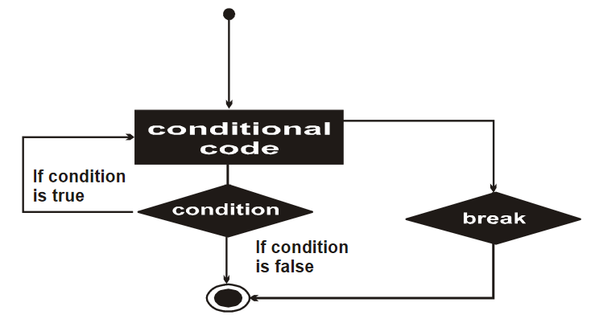
Go, change the world
RV College of
Engineering
Loop control statements
Loop control statements are those statements which regulate the way loop structure works, such that they can prematurely terminate the loop in between, they can even skip the execution of a certain iteration in the loop and even they can shift control from the loop to any other part of the program.
These statements change execution of the statement block from its normal sequence. There are basically three loop control statements viz., break, continue and goto.
break Statement
break is used to terminate the loop prematurely in which it appears.
We know so far its usage with switch-case construct and its also widely used with for, while and do-while constructs.
When the compiler encounters a break statement, the control passes to the statement that follows the loop in which the break statement appears.
syntax is quite simple, just type keyword break followed by a semi-colon.
break;
Flowchart of the break.

Slide 63
Go, change the world
RV College of
Engineering
Loop control statements….contd.,
The following program given below shows how one can use a break statement to terminate the loop in which it is appears.
As soon as ‘i’ becomes equal to 5, the break statement is executed and the control jumps to the statement following the while loop (i.e., return 0). Hence, the break statement is used to exit a loop from any point within its body, bypassing its normal termination expression.
continue Statement
It is used to skip the iteration in the loop based on the condition.
like the break statement, the continue statement cannot be used without an enclosing for, while, or do–while loop.
When the compiler sees a continue statement, the statements after the continue statement are skipped and then control is unconditionally transferred to code that tests the controlling expression.
#include <stdio.h> int main(){ int i = 0; while(i<=10) { if (i==5) break; printf("\t %d", i); i = i + 1; } return 0; }

Slide 64
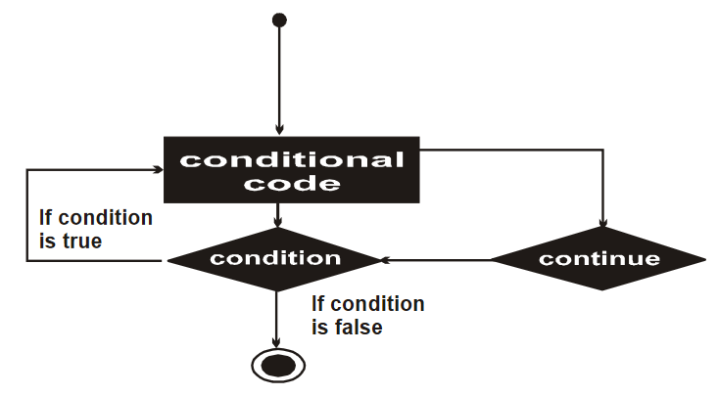
Go, change the world
RV College of
Engineering
Loop control statements….contd.,
syntax
just type keyword continue followed by a semi-colon.
continue;
If the continue statement is used in a for loop, control is transferred to an expression that updates the loop variable.
Example,
Note that the code is meant to print numbers from 0 to 10. But the loop prints all numbers from 0 to 10 but skip printing of the number 5.
In the following code when loop variable ‘i’ becomes 5, if condition(i==5) returns true and passes control to continue statement.
When the compiler encounters a continue statement, the printf() statement is skipped and the control passes to the expression that increments the value of ‘i’ (i.e., i++).
Unlike break, continue make control to stay with the loop by skipping specific iteration in the loop.
Flowchart of the continue.
#include <stdio.h> int main() { int i; for(i=0; i<= 10; i++) { if (i==5)
continue; printf("\t %d", i); } return 0; }

Slide 65
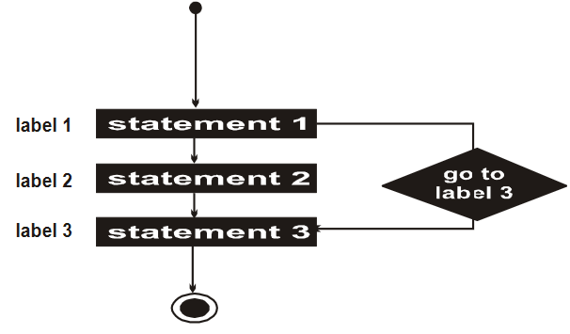
Go, change the world
RV College of
Engineering
Loop control statements….contd.,
goto statement: It is used for unconditional transfer of control from goto statement to a labeled statement in the program. Before using goto statement one needs to label statement or statement block to which he/she wants to transfer control from goto statement.
Use of goto statement is highly discouraged in any programming language because it makes it difficult to trace the flow of control in a program, making the program hard to understand and hard to modify.
In the following example, the for loop is supposed to print numbers from 0 to 10, but when the counter variable ‘i’ becomes 5, if statement evaluates the condition (i==5).
If condition is true, then the control passed to printf statement and reads user choice value, and now inner if condition (choice==‘y’) is evaluated. Otherwise control passed to exit(0), that makes the program to exit.
If the outcome of the condition (choice==‘y’) is true, now control is passed to goto statement, which passes control to label repeat1to4 just before the for loop and for loop restarts again.
Flowchart of the goto.
#include <stdio.h> int main() { int i;
char choice;
repeat1to4:
for(i=0; i<= 10; i++) { if (i==5){
printf(“Do you want print 1-4 again [y/n]: ?”);
scanf(“%c”,&choice);
If(choice==‘y’)
goto repeat1to4;
else
exit(0);
} printf("\t %d", i); }
return 0;
}

Slide 66
Go, change the world
RV College of
Engineering
Declaration of Arrays
An array is a collection of similar data elements and they all have the same data type.
The elements of the array are stored in consecutive memory locations and are referenced by an index (also known as the subscript).
The array index is an ordinal number which is used to identify an element of the array.
Declaring an array means specifying the following:
Data type—the kind of values it can store, for example, int, char, float, double.
Name—to identify the array.
Size—the maximum number of values that the array can hold.
Arrays are declared using the syntax: type name[size];
For example: int marks[10];

Slide 67
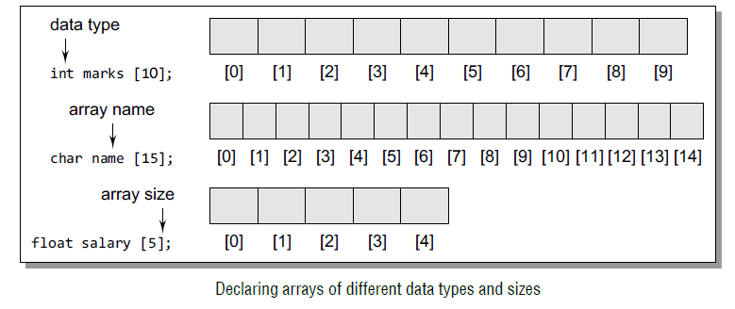
Go, change the world
RV College of
Engineering
In C, the array index starts from zero. The first element will be stored in marks[0], second element in marks[1], and so on. Therefore, the last element, that is the 10th element, will be stored in marks[9].

Slide 68
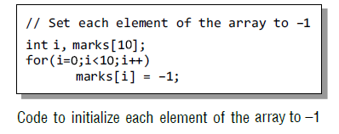
Go, change the world
RV College of
Engineering
Accessing Elements of an Array
Storing related data items in a single array enables the programmers to develop concise and efficient programs. But there is no single function that can operate on all the elements of an array.
To access all the elements, we must use a loop, i.e., we can access all the elements of an array by varying the value of the array subscript or index. But note that the subscript must be an integral value or an expression that evaluates to an integral value.

Slide 69
Go, change the world
RV College of
Engineering
Address of Array Elements
Since an array stores all its data elements in consecutive memory locations, storing just the base address, that is the address of the first element in the array, is sufficient. The address of other data elements can simply be calculated using the base address.
The formula to perform this calculation is,
Address of data element at index k = BA(A) + w(k – lower_bound)
Here, A is the array, k is the index of the element of which we have to calculate the address, BA is the base address of the array A, and w is the size of one element in memory.
The length of an array is given by the number of elements stored in it.

Slide 70
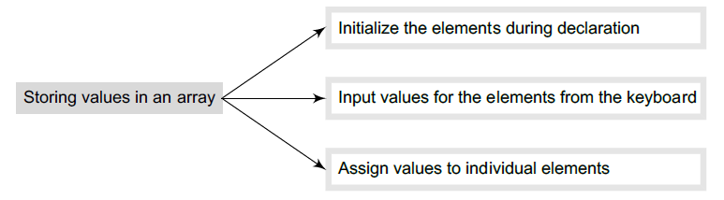

Go, change the world
RV College of
Engineering
Storing values in Arrays
Inputting Values for Array Elements
In this method, a while/do–while or a for loop is executed to input the value for each array element. An example code is given below.

Slide 71
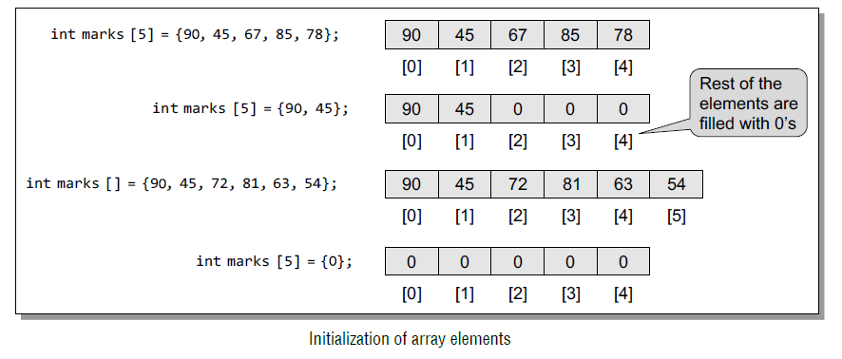
Go, change the world
RV College of
Engineering
Initializing Array Elements during Declaration
The elements of an array can be initialized at the time of declaration, just like any other variable. Various ways of initializing array elements is given below.

Slide 72
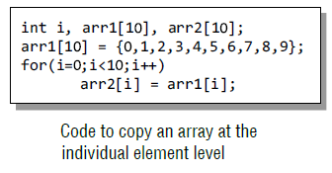
Go, change the world
RV College of
Engineering
Assigning Values to Individual Elements
In this method, individual elements of the array are given values by using the assignment operator. For example: marks[3] = 100;
It should be noted that we cannot assign one array to another array, even if the two arrays have the same type and size. To copy an array, the value of every element of the first array must be copied into the respective elements of the second array.

Slide 73
Go, change the world
RV College of
Engineering
Operations On Arrays
There are a number of operations that can be preformed on arrays and they are as follows.
Traversing an array
Inserting and deleting an element in an array
Searching an element in an array
Merging two arrays
Sorting an array in ascending or descending order
Traversing an array:
Traversing the data elements of an array can include printing every element, counting the total number of elements, or performing any process on particular elements. Since, array is a linear data structure, traversing its elements is very simple and straightforward.

Slide 74
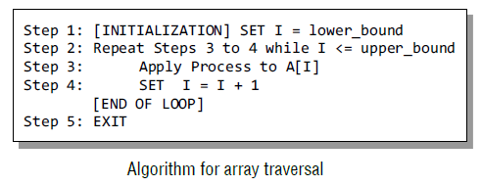
Go, change the world
RV College of
Engineering
Program to read and display n numbers using an array
#include <stdio.h>
#include <conio.h>
int main()
{
int i, n, arr[20];
printf("\n Enter the number of elements in the array : ");
scanf("%d", &n);
for(i=0; i<n; i++)
{
printf("\n arr[%d] = ", i);
scanf("%d",&arr[i]);
}
printf("\n The array elements are ");
for(i=0; i<n; i++)
printf("\t %d", arr[i]);
return 0; }

Slide 75
Go, change the world
RV College of
Engineering
Program to print the position of the smallest number in an array of n numbers.
#include <stdio.h>
#include <conio.h>
int main()
{
int i, n, arr[20], small, pos;
printf("\n Enter the number of elements in the array : ");
scanf("%d", &n);
printf("\n Enter the elements : ");
for(i=0; i<n; i++)
scanf("%d",&arr[i]);
small = arr[0];
pos =0;
for(i=1; i<n; i++)
{
if(arr[i]<small)
{
small = arr[i];
pos = i;
}
}
printf("\n The smallest element is : %d", small);
printf("\n The position of the smallest element in the array is : %d", pos);
return 0;
}

Slide 76
Go, change the world
RV College of
Engineering
Program to find whether an array of integers contains a duplicate number.
#include <stdio.h>
#include <conio.h>
int main()
{
int array[10], i, n, j, flag =0;
printf("\n Enter the size of the array : ");
scanf("%d", &n);
for(i=0; i<n; i++)
{
printf("\n array[%d] = ", i);
scanf("%d", &array[i]);
}
for(i=0; i<n; i++)
{
for(j=i+1; j<n; j++)
{
if(array[i] == array[j] && i!=j)
{
flag =1;
printf("\n Duplicate numbers found at locations %d and %d", i, j);
}
}
}
if(flag == 0)
printf("\n No Duplicates Found");
return 0;
}

Slide 77
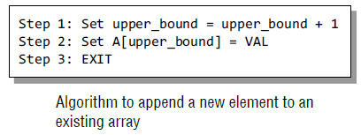
Go, change the world
RV College of
Engineering
Inserting an Element in an Array
If an element has to be inserted at the end of an existing array, then the task of insertion is quite simple. We just have to add 1 to the upper_bound and assign the value.
Here, we assume that the memory space allocated for the array is still available. For example, if an array is declared to contain 10 elements, but currently it has only 8 elements, then obviously there is space to accommodate two more elements. But if it already has 10 elements, then we will not be able to add another element to it.

Slide 78
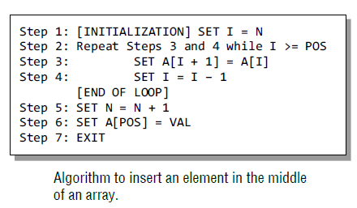
Go, change the world
RV College of
Engineering
Inserting an Element in an Array
If an element has to be inserted in the middle of the array, then the task of insertion involves the algorithm shown here.
To do this process, the location where the new element will be inserted is to be found out.
Then all the elements to the right of this array location has to be moved one position right, so that space can be created to store the new value.

Slide 79
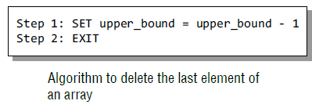
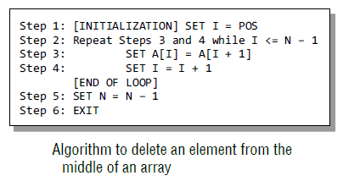
Go, change the world
RV College of
Engineering
Deleting an Element in an Array
Deleting an element from an array means removing a data element from an already existing array. Deleting an element at the end of the existing array is quite simple.
To delete an element in the middle of an array, we must first find the location from where the element has to be deleted and then move all the elements one position towards left.
Thus the space vacated by the deleted element will be occupied by rest of the elements.

Slide 80
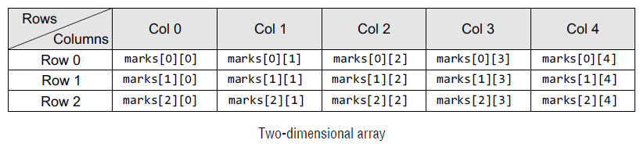

Go, change the world
RV College of
Engineering
Two Dimensional Arrays
A two-dimensional array is declared as: data_type array_name[row_size][column_size];
Therefore, a two-dimensional $m×n$ array contains m*n data elements and each element is accessed using two subscripts, i and j, where i <= m and j <= n.
A two-dimensional array is initialized in the same way as a one-dimensional array is initialized. For example: int marks[2][3]={90, 87, 78, 68, 62, 71};
Note that the initialization of a two-dimensional array is done row by row. The above statement can also be written as: int marks[2][3]={{90,87,78},{68, 62, 71}};

Slide 81
Go, change the world
RV College of
Engineering
Two Dimensional Arrays
In case of one-dimensional arrays, we used a single for loop to vary the index i in every pass, so that all the elements could be scanned. Since the two-dimensional array contains two subscripts, we will use two for loops to scan the elements.
The first for loop will scan each row in the 2D array and the second for loop will scan individual columns for every row in the array.
Program to print the elements of a 2D array
#include <stdio.h>
#include <conio.h>
int main()
{
int arr[2][2] = {12, 34, 56,32};
int i, j;
for(i=0;i<2;i++)
{
printf("\n");
for(j=0;j<2;j++)
printf("%d\t", arr[i][j]);
}
return 0;
}

Slide 82

Go, change the world
RV College of
Engineering
Operations on Two Dimensional Arrays
Two-dimensional arrays can be used to implement the mathematical concept of matrices. In mathematics, a matrix is a grid of numbers, arranged in rows and columns. Thus, using two dimensional arrays, we can perform the following operations on an $m×n$ matrix:
Transpose of an $m×n$matrix A is given as a $n×m$ matrix B, where B_{i,j} = A_{j,i}.
Sum and Difference: Two matrices that are compatible with each other can be added or subtracted together, storing the result in the third matrix. Two matrices are said to be compatible when they have the same number of rows and columns. The elements of two matrices can be added by writing:
C_{i,j} = A_{i,j} + B_{i,j}
The elements of two matrices can be subtracted by writing:
C_{i,j} = A_{i,j} – B_{i,j}.

Slide 83
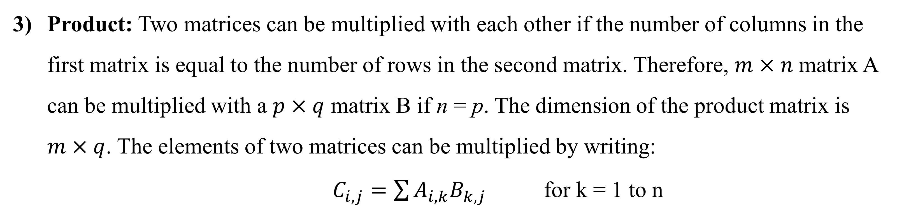
Go, change the world
RV College of
Engineering
Operations on Two Dimensional Arrays
Product: Two matrices can be multiplied with each other if the number of columns in the first matrix is equal to the number of rows in the second matrix. Therefore, $m×n$matrix A can be multiplied with a $p×q$ matrix B if n = p. The dimension of the product matrix is $m×q$. The elements of two matrices can be multiplied by writing:
$C_{i,j}=\sum{A_{i,k}B_{k,j}}$ for k = 1 to n

Slide 84
Go, change the world
Program : Transpose of a matrix
RV College of
Engineering
#include <stdio.h>
int main() {
int a[10][10], transpose[10][10], r, c;
printf("Enter rows and columns: ");
scanf("%d %d", &r, &c);
// asssigning elements to the matrix
printf("\nEnter matrix elements:\n");
for (int i = 0; i < r; ++i)
for (int j = 0; j < c; ++j) {
printf("Enter element a%d%d: ", i + 1, j + 1);
scanf("%d", &a[i][j]);
}
// printing the matrix a[][]
printf("\nEntered matrix: \n");
for (int i = 0; i < r; ++i)
for (int j = 0; j < c; ++j) {
printf("%d ", a[i][j]);
if (j == c - 1)
printf("\n");
}
// computing the transpose
for (int i = 0; i < r; ++i)
for (int j = 0; j < c; ++j) {
transpose[j][i] = a[i][j];
}

Slide 85
Go, change the world
Program to add two matrices
RV College of
Engineering
#include <stdio.h>
int main() {
int r, c, a[100][100], b[100][100], sum[100][100], i, j;
printf("Enter the number of rows (between 1 and 100): ");
scanf("%d", &r);
printf("Enter the number of columns (between 1 and 100): ");
scanf("%d", &c);
printf("\nEnter elements of 1st matrix:\n");
for (i = 0; i < r; ++i)
for (j = 0; j < c; ++j) {
printf("Enter element a%d%d: ", i + 1, j + 1);
scanf("%d", &a[i][j]);
}
printf("Enter elements of 2nd matrix:\n");
for (i = 0; i < r; ++i)
for (j = 0; j < c; ++j) {
printf("Enter element b%d%d: ", i + 1, j + 1);
scanf("%d", &b[i][j]);
}
// adding two matrices
for (i = 0; i < r; ++i)
for (j = 0; j < c; ++j) {
sum[i][j] = a[i][j] + b[i][j];
}
// printing the result
printf("\nSum of two matrices: \n");
for (i = 0; i < r; ++i)
for (j = 0; j < c; ++j) {
printf("%d ", sum[i][j]);
if (j == c - 1) {
printf("\n\n");
}
}
return 0;
}

